Slide 1

E-Commerce Marketplace Performance Analysis
Data-Driven Insights & Strategic Recommendations

Slide 2
Project Overview & Data Scope
Objective: To analyze 118k+ transactions to identify growth drivers and customer behavior.
Data Sources: 6 Relational datasets (Orders, Customers, Payments, Products, Sellers, and Items).
Tools Used: Python (Pandas/Seaborn), SQL, and Google Colab.

Slide 3
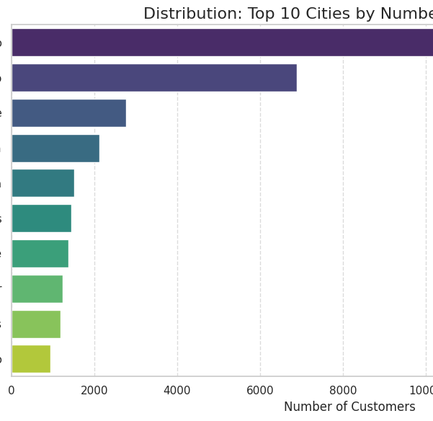
Geographic Distribution
Market Leader: São Paulo (SP) is the dominant hub with over 41,000 customers.
Concentration: The top 3 states (SP, RJ, MG) account for the vast majority of total volume.
Niche Markets: Smaller cities show a higher average item count per order, indicating bulk-buying behavior in remote areas.

Slide 4
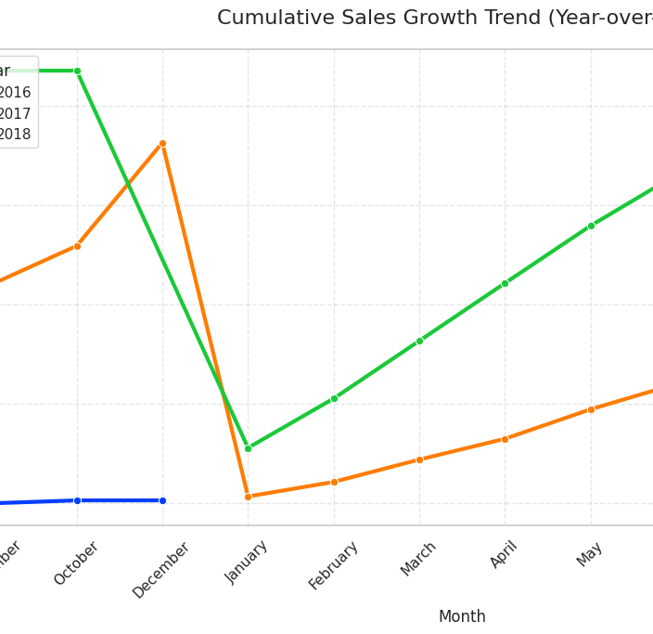
Sales Performance & Growth Trends
Annual Growth: Achieved a 20% YoY growth rate in 2018 (up to August) compared to 2017.
Seasonality: Identified a massive spike in November, likely linked to Black Friday events.
Scaling: 2018 revenue surpassed the entire 2017 total in just 8 months.

Slide 5
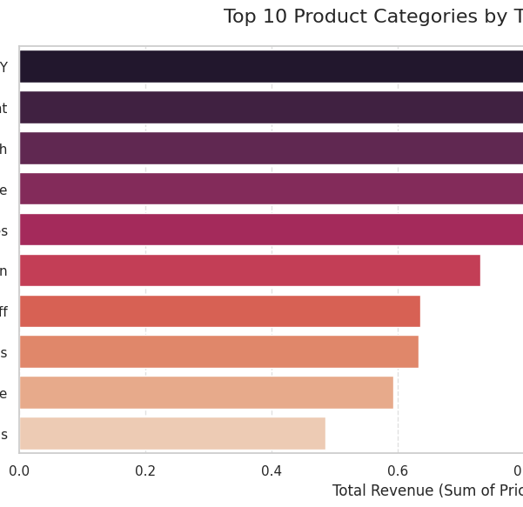
Revenue Drivers (Category Analysis)
Top Categories: Health & Beauty and Watches & Gifts are the highest revenue generators.
Concentration: The top 10 categories contribute to 62.3% of total marketplace revenue.
Insight: High-value items (Watches) drive revenue even with lower order frequency than home essentials.

Slide 6
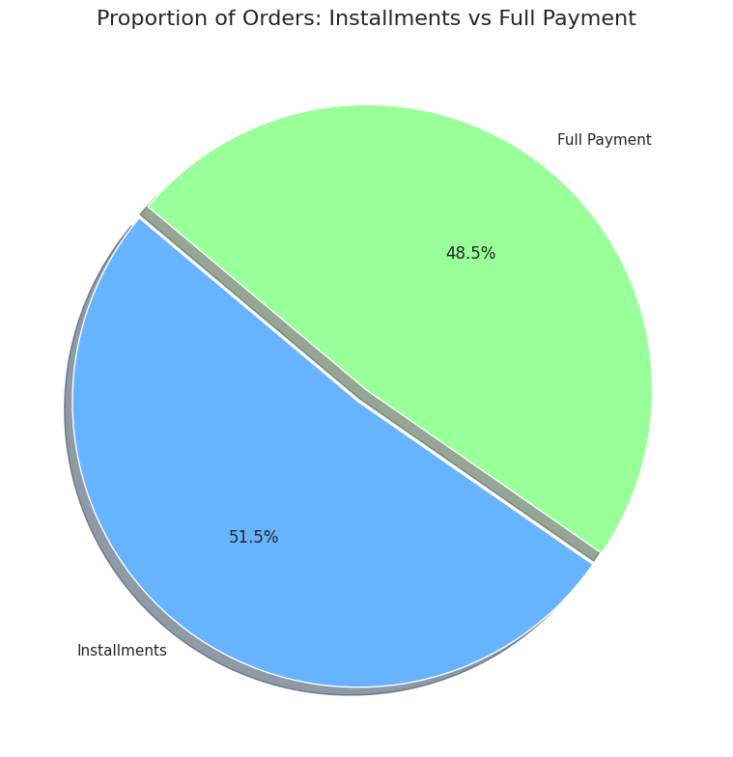
Financial & Payment Insights
Payment Preference: 51.5% of orders are paid via installments.
Credit Dependency: The ability to split payments is a critical driver for high-ticket item conversion.
Average Value: Credit card transactions consistently represent the highest order values compared to Boleto or Debit.

Slide 7
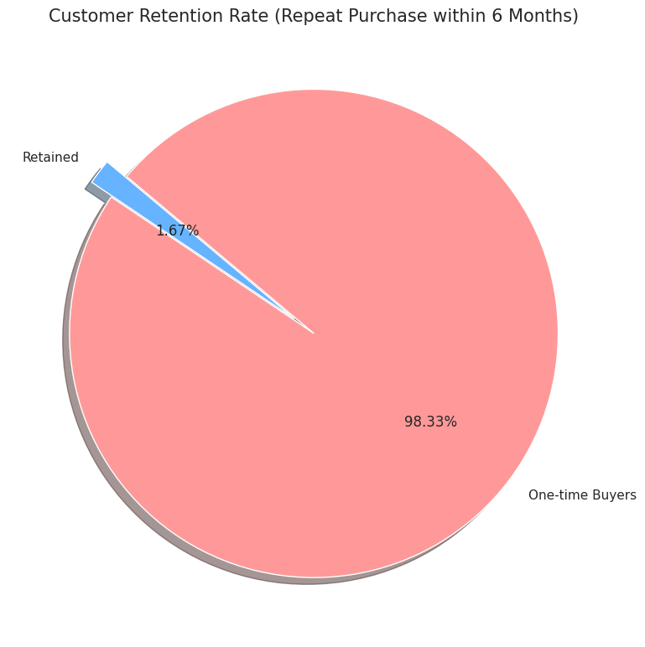
Customer Behavior & Retention
Retention Rate: Currently at 1.67% (repeat purchase within 6 months).
Analysis: The platform acts as a "Discovery Engine"—excellent at acquiring new users but needing better re-engagement strategies.
LTV: A small segment of "Power Users" contributes significantly to annual spending.

Slide 8
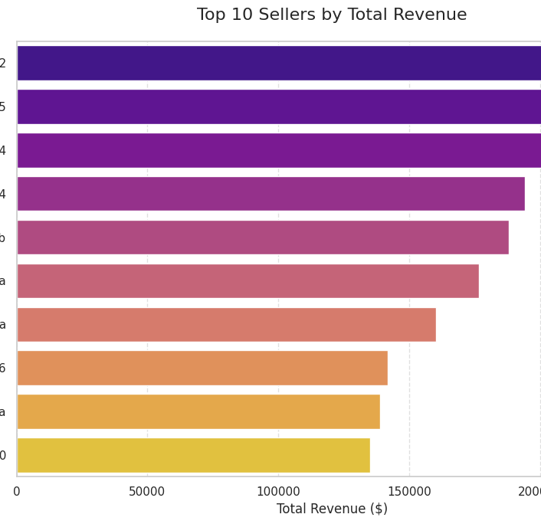
Seller Performance
Merchant Landscape: Highly competitive top tier; the top 10 sellers are closely ranked by revenue.
Leader: Top seller generated over $229k in the analyzed period.
Opportunity: High correlation between seller diversity and category dominance in Health/Beauty.

Slide 9
Strategic Recommendations
Retention: Launch a Loyalty Program targeting high-frequency categories like Health & Beauty.
Logistics: Implement "Next-Day Delivery" for São Paulo to defend market share.
Marketing: Scale ad spend 4 weeks prior to the November peak to capitalize on established seasonality.

Slide 10
Conclusion
The marketplace is in a high-growth phase with a strong urban foundation.

Slide 11
Thank You
LinkedIn: https://www.linkedin.com/in/ruchir-a-308240128/
GitHub: https://github.com/ruchira559

